Slide 1
Improving Language Understanding by Generative Pre-Training
Team Members: Asmita Mukherjee , Aurko Mitra ,Ayush Agarwal ,Ayushi Jain, Charvi Jindal, Chetan IIITD
Key Contributions
Introduction of decoder only model inspired by an ICLR 2018 paper “GENERATING WIKIPEDIA BY SUMMARIZING LONG SEQUENCES ”.
2 Stage Training : Unsupervised “generative pre training” and supervised “discriminative fine tuning”
Task aware input transformations: This helps achieves minimal change to the model architecture while it being applicable to the wide variety of task on which it is applied.
Evaluation and training on wide range of natural language understanding tasks.

Slide 2
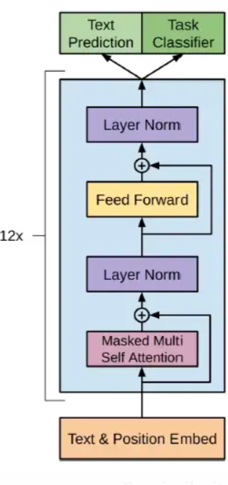
Proposed Architecture
Decoder only approach : Encoder decoder models: bulky, requires more data to fine tune and complexity in deployment.
Uses 12 layers of T-DMCA (Transformer Decoder with memory compressed attention).
Memory Compressed Attention : To handle longer sequences, the multi-head self-attention of the Transformer is modified to reduce memory usage by limiting the dot products between Q and K.
Output consists of 2 heads as GPT aims to fine tune on a variety of natural language understanding tasks while keeping language modelling as its auxiliary task.
Task aware input transformations:Since different tasks require the input to be in different format, an approach is taken to convert structured inputs to ordered sequences so that the pretrained model can process it without any extensive change to its architecture.

Slide 3
Performance/ Model Comparison
Transformer | GPT | BART
Encoder-decoder architecture | Autoregressive Decoder only architecture | Bidirectional Encoder and Autoregressive decoder
6 layers each of encoder and decoder stacked. | 12 layers of decoder. | BART base : 6 layers of Enc-Dec BART larger : 12 layers of Enc-Dec
Sinusoidal positional embedding | Learned position embedding. | As in standard transformer
Activation function Relu in linear layers | Activation function of GElu in linear layers. | Activation function of GElu in linear layers.
BPE | BPE was used for tokenizing the input. | BPE encoding
Model | NLI Task | QA/Common sense reasoning | Semantic Similarity | Classification
BART | RTE : 87.0 MNLI-m :89.9 MNLI -mm : 90.1 | On ELI5 dataset BART outperforms best previous work by 1.2 ROUGE-L | QQP : 92.5 | SST : 96.6%
GPT | : MNLI-m :82.1 , MNLI-mm : 81.4 ( upto 5% inc) , RTE with acc of 56% | 86.5% on Story Cloze test | 70.3% :QQP | 91.3% : SST

